Slide 1


Component Validation Methods
- Black-Box Testing
By Jerry Zeyu Gao, Ph.D.
San Jose State University
Email: jerrygao@email.sjsu.edu
URL:/www.engr.sjsu.edu/gaojerry
@Copyright by Jerry Zeyu Gao

Slide 2

Week #4 - Module #1
Component Validation Methods
- Black-Box Testing
Speaker: Jerry Gao Ph.D.
Computer Engineering Department
San Jose State University
email: jerry.gao@sjsu.edu
URL: http://www.engr.sjsu.edu/gaojerry
Copyright © 2013, All Right Reserved by Jerry Gao, Ph.D.

Slide 3
Presentation Outline
Component Validation Methods - Black-Box Testing
Software component validation
Black-box testing methods for components
  Random testing
  Partition testing
  Boundary value testing
  Decision table-based testing
  Mutation testing
@Copyright by Jerry Zeyu Gao

Slide 4
Component Validation Methods - Black-Box Testing
Software Component Validation
There are many different software validation methods for components.
They have been classified into two classes:
White-box validation methods (also known as program-based testing methods, or structure-based testing methods)
  They refer to the systematic techniques for testers to design and generate test cases and data to achieve a certain test adequacy criteria for a component based on its component program and structure.
Black-box validation methods (also known as functional testing methods)
  They refer to the systematic techniques for testers to design and generate test cases and data to achieve a certain test adequacy criteria for a component based on its component specifications.
@Copyright by Jerry Zeyu Gao

Slide 5
Component Validation Methods - Black-Box Testing
Software Component Validation
Component customization:
When a component is adopted or customized by component users,
Generalization customization:
  A component is adopted by a user in a way to release some component requirement restrictions in component specifications.
Specialization customization:
  A component is adopted by a user in a way to add more requirement restrictions in component specifications.
Reconstruction customization:
  A component is adopted or updated by a user in a way to change input domains in component specifications.
@Copyright by Jerry Zeyu Gao

Slide 6
Component Validation Methods - Black-Box Testing
Different Cases for Component Validations
Adding Parts
Disable or
Non-reused Parts
Reused
Components
Reused
Components
Partial Reuse
Complete Reuse
Adding Parts
Disable or
Non-reused Parts
Adding Parts
Reused
Components
Reused
Components
Complete Reuse
Partial Reuse
@Copyright by Jerry Zeyu Gao

Slide 7
Component Validation Methods - Black-Box Testing
Black-box Testing Methods for Components
Black-box testing -> known as functional testing
Basic idea: testing a component as a black box.
It focuses only on the external accessible behaviors and functions
It checks a component’s outputs for selected component inputs
In CBSE, black-box testing is very important for component users to validate and evaluate component quality.
According to IEEE Standard, black-box testing is:
  “Testing that ignores the internal mechanism of a system or component and focuses solely on the outputs generated in response to selected inputs and execution conditions;”
  “Testing conducted to evaluate the compliance of a system or component with specified functional requirements”
The primary objective:
-> to assess whether the software component does what it is supposed to do.
@Copyright by Jerry Zeyu Gao

Slide 8
Component Validation Methods - Black-Box Testing
Black-box Testing Methods for Components
Black-box testing methods for components can be classified into three groups:
Usage-based black-box testing techniques – focusing on user-oriented accesses
  User-operation scenario testing
  Random testing
  Statistical testing
Error-based black-box testing techniques – focusing on error-prone points
  Equivalence partitioning testing
  Category-partition testing
  Boundary-value analysis
  Decision table-based testing
Fault-based black-box testing techniques – focusing on targeted fault points
  Mutation testing
  Fault injection method
@Copyright by Jerry Zeyu Gao

Slide 9
Component Validation Methods - Black-Box Testing
Black-box Testing Methods for Components
In CBSE, black-box testing can be used by component users as well as component test engineers.
For component vendors:
Their component test engineers can use all existing black-box testing methods to validate newly generated components.
For a component users:
Their engineers can apply existing black-box testing methods by pay attention to the following issues:
  Very limited access to quality information about COTS components, such as quality metrics and reports, and problem reports
  Limited observation for component behaviors (i.e. user-level traces)
  Component specification mismatch
  Component customization and adoption cause test adequacy issues
  Costly construction of component test beds and harness for each component
@Copyright by Jerry Zeyu Gao

Slide 10
Component Validation Methods - Black-Box Testing
Black-box Testing Methods for Components
Random Testing
Basic idea: randomly select input values from an input domain of a component as the inputs for test cases.
Advantages of this approach:
  a) simple and Systematic b) gain certain test coverage for each input domain
Although input values can be generated and selected randomly based on input domains of a component, we need to confirm to the distribution of the input domain, or an operation profile.
i.e. ATM system: 80% withdraw, 15% deposit, %5 other transactions.
Questions in random testing for software components
Can we identify all input domains of a component?
What are user profiles and input distribution for each input domain?
How much of the efforts undertaken by the component providers can be reused?
What is the targeted test coverage for input distribution in each input domain?
How much additional testing efforts is required?
@Copyright by Jerry Zeyu Gao

Slide 11
Component Validation Methods - Black-Box Testing
Black-box Testing Methods for Components
Partition Testing
Basic idea: Divide the input domains of a component into N different disjoint partitions, and select one value from each input domain to create a test case.
The major problem -> Lack of systematic methods to partition input domains of a component for the given non-formal function specifications.
T. J. Ostrand and M. J. Balcer proposed a systematic method known as Category partition testing method→ consisting of the following steps:
  Decompose function specifications into functional units
  Identify parameters and environment conditions
  Find categories of information
  Partition each category into choices
  Write test specification for each unit
  Produce test frames
  Generate test cases
@Copyright by Jerry Zeyu Gao

Slide 12
Component Validation Methods - Black-Box Testing
Black-box Testing Methods for Components
Partition Testing (Test Specification Example)
Parameters:
  PIN
  Wrong PIN [property mismatch]
  Correct PIN [property match]
  Withdraw amount
  Multiple of 20 [if match]
  [property correct]
  Less than 20 [if match]
  [property wrong]
  Greater than 20 but not multiple of 20
  [if match]
  [property wrong]
@Copyright by Jerry Zeyu Gao

Slide 13
Component Validation Methods - Black-Box Testing
An Example of Using The Category-Partition Method
Test a command-line program that supports “find” operation as follows:
Command:
find
Syntax:
find <pattern> <file>
Function:
The find command is used to locate one or more instances of
a given pattern in a text file. All lines in the file that contain the
pattern are written to standard output. A line containing the
pattern is written only once, regardless of the no. of times the
pattern occurs in it.
The pattern is any sequence of characters whose length does
not exceed the maximum length of a line in the file. To include
a blank in the pattern, the entire pattern must be enclosed in
quotes (“). To include a quotation mark in the pattern, two
quotes in a row (“ ”) must be used.
@Copyright by Jerry Zeyu Gao

Slide 14
Component Validation Methods - Black-Box Testing
An Example of Using The Category-Partition Method
Examples:
find john myfile
displays lines in the file myfile which contain john.
find “john smith” myfile
display lines in the file myfile which contains john smith.
find “john” ” smith” myfile
display lines in the file which contains john” smith.
When file is considered as a parameter, we need to consider the following:
- no. of occurrences of the pattern in the file.
- no. of occurrences of the pattern in a line that contains it.
- maximum line length in the file
……
@Copyright by Jerry Zeyu Gao

Slide 15
Component Validation Methods - Black-Box Testing
An Example of Using The Category-Partition Method
Test specification for Find command:
Parameters:
Pattern size:
    empty
single character
many character
longer than any line in the file
Quoting:
    Pattern is quoted
    Pattern is not quoted
pattern is improperly quoted
Embedded blanks:
    no embedded blank
    One embedded blank
    Several embedded blanks
@Copyright by Jerry Zeyu Gao

Slide 16
Component Validation Methods - Black-Box Testing
An Example of Using The Category-Partition Method
Test specification for Find command:
Parameters:
Embedded quotes:
    no embedded quotes
    One embedded quote
    Several embedded quote
File name:
    Good file name
    No file with this name
    Omitted
@Copyright by Jerry Zeyu Gao

Slide 17
Component Validation Methods - Black-Box Testing
An Example of Using The Category-Partition Method
Test specification for Find command:
Environment: (only for the pattern)
File access environment
    File not accessible
    File can’t read
    File can’t open
- No. of occurrences of pattern in the file.
None
Exactly one
More than one
Pattern occurrences on target line:
  one
  more than one
  None
@Copyright by Jerry Zeyu Gao

Slide 18
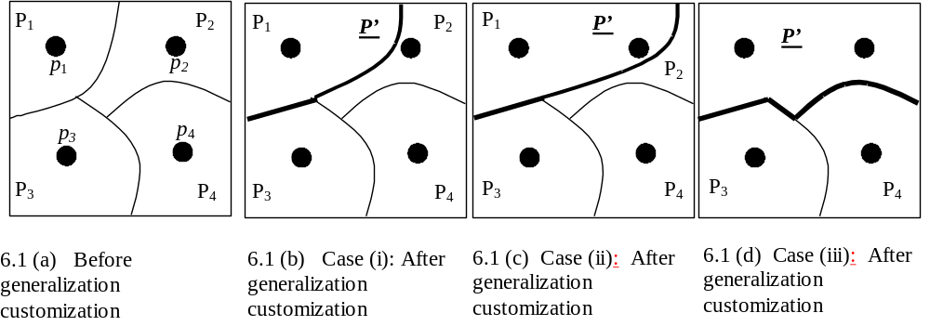
Component Validation Methods - Black-Box Testing
Black-box Testing Methods for Components
Partition Testing of Generalization Customization:
@Copyright by Jerry Zeyu Gao

Slide 19
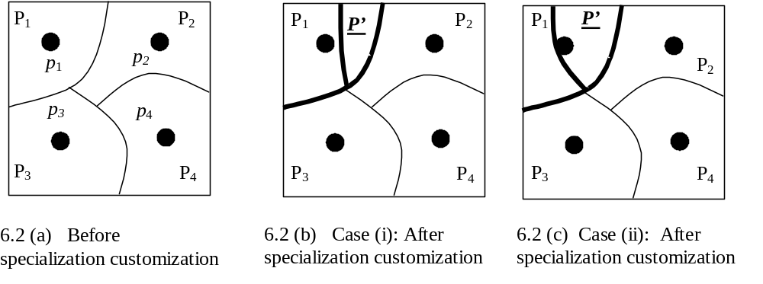
Component Validation Methods - Black-Box Testing
Black-box Testing Methods for Components
Partition Testing for Specialization Customization:
@Copyright by Jerry Zeyu Gao

Slide 20
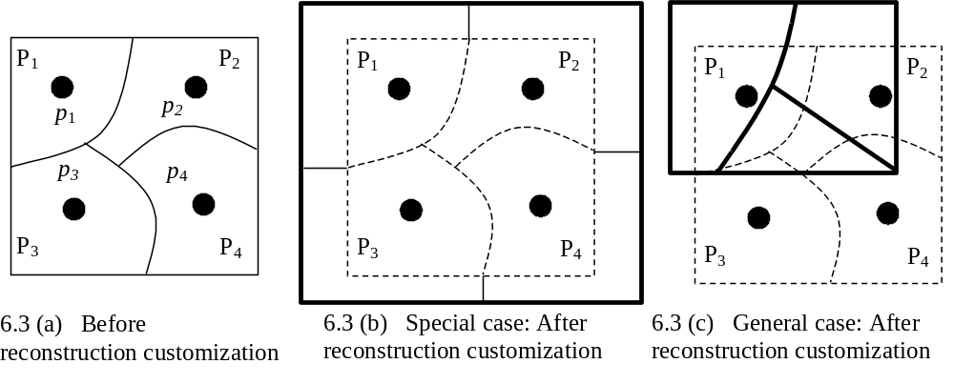
Component Validation Methods - Black-Box Testing
Black-box Testing Methods for Components
Partition Testing for Reconstruction Customization:
@Copyright by Jerry Zeyu Gao

Slide 21
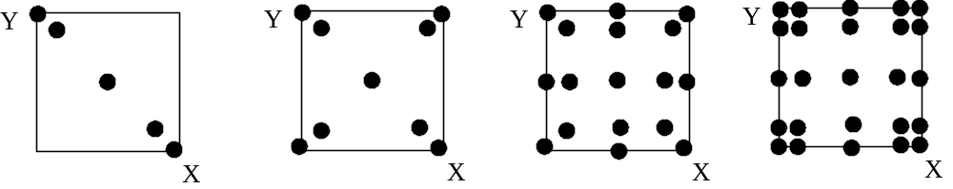
Component Validation Methods - Black-Box Testing
Black-box Testing Methods for Components
Boundary Value Testing
Basic idea:
For each partition for an input domain, select boundary values for this partition to generate test cases.
Advantages of this approach:
easy to systematically implemented b) more like to expose errors
boundary values for one-dimensional space x in [X_{min}, X_{max}], y in [Y_{min}, Y_{max}]:
a. X_{min}, X_{min+1}, X_{mid}, X_{max-1}, X_{max} b. X_{min-1}, X_{min}, X_{min+1}, X_{mid}, X_{max}, X_{max+1}
@Copyright by Jerry Zeyu Gao

Slide 22
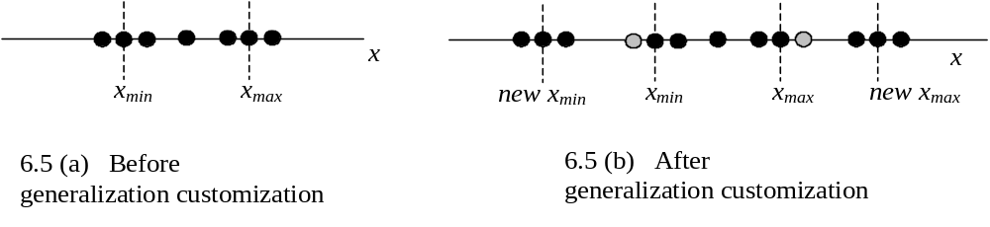
Component Validation Methods - Black-Box Testing
Black-box Testing Methods for Components
Boundary Value Testing:
@Copyright by Jerry Zeyu Gao

Slide 23
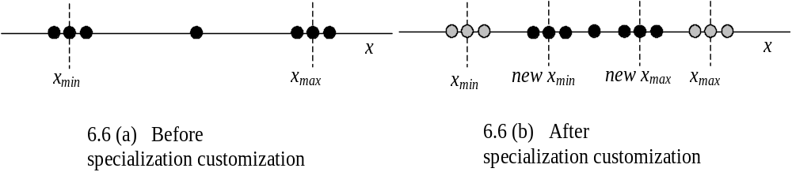
Component Validation Methods - Black-Box Testing
Black-box Testing Methods for Components
Boundary Value Testing – generalization customization:
→ Merge boundaries, add new boundaries and new boundary values
Boundary Value Testing – generalization customization:
→ Add, change boundaries and new boundary values
@Copyright by Jerry Zeyu Gao

Slide 24
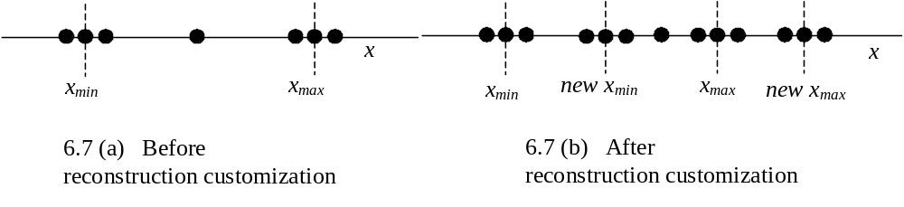
Component Validation Methods - Black-Box Testing
Black-box Testing Methods for Components
Boundary Value Testing:
→ Introduce new boundaries and values to overlap old boundaries.
@Copyright by Jerry Zeyu Gao

Slide 25
Component Validation Methods - Black-Box Testing
Black-box Testing Methods for Components
Decision Table-Based Testing:
→ focuses on validating business rules, conditions, constraints and corresponding responses and actions of a software component.
Basic approach:
Identify and list all possible conditions and their combination cases
Identify and list all possible responding actions and outputs for each case
Define test cases to cover each case
For adopted and customized software components, we need to pay the attention to:
Generalization customization:
  -> Change decision tables by removing or merging conditions and actions
Specialization customization:
  -> Change decision tables by adding new conditions and corresponding actions
Reconstruction customization:
  ->Change decision tables by adding/updating/removing conditions and related actions.
@Copyright by Jerry Zeyu Gao

Slide 26
Component Validation Methods - Black-Box Testing
An Example
Testing a triangle analyzer:
Program specification:
Input: 3 numbers separated by commas or spaces
Processing:
Determine if three numbers make a valid triangle; if not, print
message NOT A TRIANGLE.
If it is a triangle, classify it according to the length of the sides as scalene
(no sides equal), isosceles (two sides equal), or equilateral (all sides equal).
If it is a triangle, classify it according to the largest angle as acute (less than
90 degree), obtuse (greater than 90 degree), or right (exactly 90 degree).
Output: One line listing the three numbers provided as input and the
classification or the not a triangle message.
@Copyright by Jerry Zeyu Gao

Slide 27
Component Validation Methods - Black-Box Testing
Black-box Testing Methods for Components
Decision Table-Based Testing:
Conditions | C1: a<b+c C2: a=b C3: b=c | F - - | T T T | T T F | T F T | T F F
Actions | Not a triangle Scalene Isosceles Equilateral | X | X | X | X | X
Assume a≥b≥c>0. Table 6.1. Decision table based testing example
Conditions | C1: a<b+c C2: a=b or b=c | F - | T T | T F
Actions | Not a triangle Scalene Regular | X | X | X
Assume a≥b≥c>0. Table 6.2 Decision table for generalization customization
@Copyright by Jerry Zeyu Gao

Slide 28
Component Validation Methods - Black-Box Testing
Black-box Testing Methods for Components
Decision Table-Based Testing:
Conditions | C1: a<b+c C2: a=b C3: b=c C4: a²=b²+c² | F - - - | T T T - | T T F - | T F T - | T F F - | - - - T
Actions | Not a triangle Scalene Isosceles Equilateral Right Triangle | X | X | X | X | X | X
Assume a≥b≥c>0
Table 6.3 Partial decision table for specialization customization
@Copyright by Jerry Zeyu Gao

Slide 29
Component Validation Methods - Black-Box Testing
Another Example – Testing a software Stack Component (class)
Assume you are given an integer stack component which is specified below. Please answer the following questions:
Stack::Create_stack(Stack S) – Create an empty queue.
Stack::Push(Stack S, int item)
– Append an item into a given stack. Please make sure the queue is not full yet when you push an item. Otherwise, an alerting message will be printed out.
Stack: Pop(Stack S, int item)
– Pop an item from a given stack. Please make sure that the stack is not empty before this operation. Otherwise, an alerting message will be printed out.
Stack: Is_Empty(Stack S)
- This function checks if the given stack is empty, and returns 1 if it is empty. Otherwise, returns 0.
(Hint: Please identify the different conditions of a Queue and related Stack’s operations and results).
(a) Create a decision table to list the conditions, actions, and related results. (5%)
(b) Design and list the test cases based on the derived decision table. (5%)
Assume the maximum number of the elements in a queue is 100.
@Copyright by Jerry Zeyu Gao

Slide 30
Component Validation Methods - Black-Box Testing
Decision Table-Based Testing Example
Decision Table-Based Testing:
Conditions | C1: Stack = Empty C2: Stack = FULL C3: Stack existing | T F T | F T T | F F T
Actions | Create_Stack() Push_Item() Pop_Item() IS_Empty() | OUT1 OUT3 OUT5 OUT7 | OUT2 OUT4 OUT6 OUT8 | OUT2 OUT3 OUT6 OUT8
Outputs:
OUT1: “A stack is created successfully”.
OUT2: “A stack is existing”.
OUT3: “An item is pushed into a stack.”
OUT4: “The stack is full, the item can’t be pushed into the stack”.
OUT5: “The stack is empty, the pop-up action is not completed”.
OUT6: “An item is popped-up from the stack”.
OUT7: “The stack is empty”.
OUT8: “The stack is not empty”.
@Copyright by Jerry Zeyu Gao

Slide 31
Component Validation Methods - Black-Box Testing
Black-box Testing Methods for Components
Flow Graph-Based Testing:
Objective: to check different user-oriented sequences to access component functions through its interfaces.
The basic idea: (similar to existing white-box test methods, i.e. basis-path testing)
(a) generate a flow graph for a component based on its formal specifications.
(b) use a flow graph as a test model to generate feasible flow paths.
(c) generate test cases based on executable flow paths.
(d) run the test cases to achieve defined test coverage based on the test model
Advantages: easy understand and partially systematic
Limitation:
Manual efforts in identify infeasible paths
Highly dependent on formal component specifications
@Copyright by Jerry Zeyu Gao

Slide 32
Component Validation Methods - Black-Box Testing
Black-box Testing Methods for Components
Flow Graph-Based Testing: (Example given by S. H. Edward)
Initialize
Enqueue
Swap
Is_Empty
Dequeue
Finalize
Figure 8.4. The Queue Flowgraph [6]
@Copyright by Jerry Zeyu Gao

Slide 33
Component Validation Methods - Black-Box Testing
Black-box Testing Methods for Components
A RESOLVE
queue specification:
concept Queue_Template
context
global conext
facility Standard_Boolean_Facility
parametric context
type Item
interface
type Queue is modeled by string of math[Item]
exemplar q
initialization
ensures q = empty_string
operation Enqueue (
alters q : Queue
consumes x : Item
)
ensures q = #q * <#x>
operation Dequeue (
alters q : Queue
produces x : Item
)
requires q /= empty_string
ensures <x> * q = #q
operation Is_Empty (
preserves q : Queue
) : Boolean
ensures Is_Empty iff q = empty_string
end Queue_Template
@Copyright by Jerry Zeyu Gao

Slide 34
Component Validation Methods - Black-Box Testing
New Black-Box Component Test Coverage Criteria
Component API-Based Function Access Coverage:
  Focus on:
    Component API-based functional accesses
    Component API-based access sequences
  Test model:
    Component Function Access Graphs (CFAG)
    Dynamic Component Function Access Graph (D-CFAG)
  Test coverage:
    Node coverage, all-node coverage
    Transition coverage, all-transition coverage
    Condition-transition coverage
    Path coverage between two nodes
    Minimum-path coverage between two nodes
    All-nodes and all-links coverage
@Copyright by Jerry Zeyu Gao

Slide 35
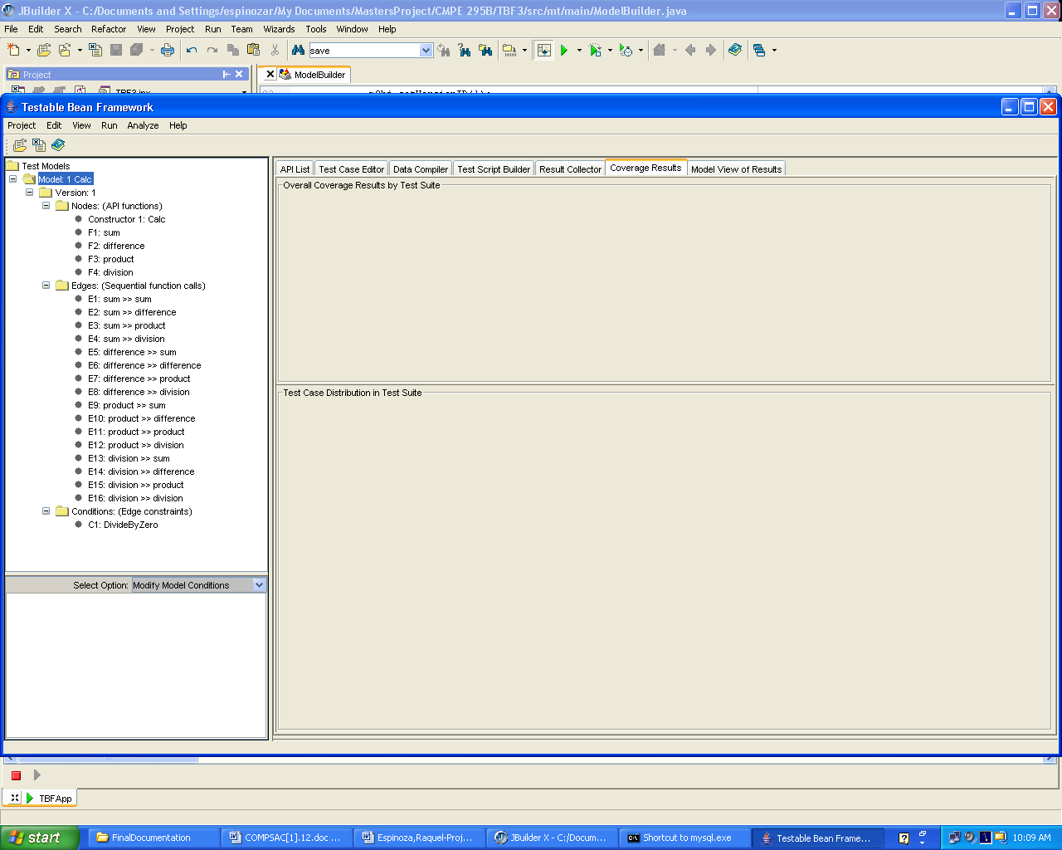
Component Validation Methods - Black-Box Testing
An Example of CFAG Test Model
@Copyright by Jerry Zeyu Gao

Slide 36
Component Validation Methods - Black-Box Testing
An Example of CFAG Test Model
E1
E2
E3
E13
E9
E5
E7
E6
E11
E10
E12
E8
E4
E14
E15
E16
Figure 2. CFAG Test Model for a Calculator Component (Graphic Format)
@Copyright by Jerry Zeyu Gao

Slide 37
Component Validation Methods - Black-Box Testing
Black-box Testing Methods for Components
Mutation Testing: (known as mutation analysis)
a fault-based testing technique that determine test adequacy by measuring the ability of a test suite to discriminate a component from some alternative copies (mutants).
Basic approach: (for the same test suite)
Introduce a single, small legal program change (syntactic level) the component
Create the alternative programs (mutants)
Execute mutants and the original program based on the same test set
Comparing the outputs of each test case
After tried all test cases in the set, if a mutant generates the same outputs as the original component, then
  the mutant = the original component.
Finally, compute the mutation score as follows:
    |dead mutants| / (|total mutants|-|equivalent mutants|)
@Copyright by Jerry Zeyu Gao

Slide 38
Component Validation Methods - Black-Box Testing Testing
Black-box Testing Methods for Components
Mutation Testing: (known as mutation analysis)
Basic problems:
(a) usually require source code to create mutants
(b) traditional mutation testing are very expensive due to testing of the large number of mutants
Why mutation testing is useful for component black-box testing?
We want to expose the interface errors of third-party components
Ghosh and Mathur [23] and Edwards[24] pointed out that mutation could be an effective method to discover component interface errors .
We can create component mutants based on component black-box interfaces.
@Copyright by Jerry Zeyu Gao

